Slide 1
Understanding the Impact of Airbnb on Gentrification & Homelessness
In the City of Toronto
Angela Huang
April 2022

Slide 2
Business Case

Slide 3
Background
Homelessness is an urgent and growing issue in Toronto.
94 per cent of those experiencing homelessness in Toronto want permanent housing, but face barriers in securing it.
In the past 10 years, average market rent for a one-bedroom has increased by 33 per cent.
There are thousands of homes that could be on the long-term rental market but aren’t.
Many of these are owned by absentee investors who are leaving them vacant for their eventual use, but many more are owned by Airbnb hosts who can make more on Short-Term rentals than they could renting long-term to a family.
Notes:
https://homesfirst.on.ca/about-toronto-homelessness/

Slide 4
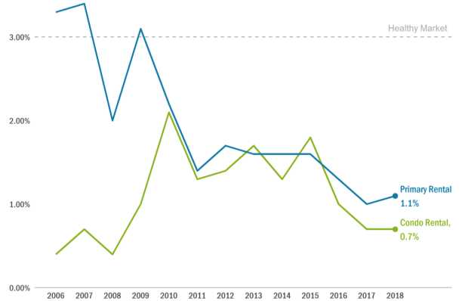
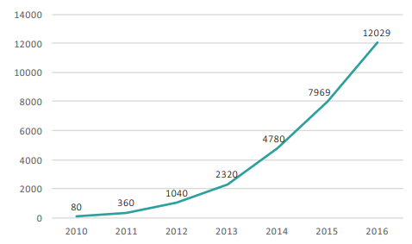
Toronto Rental Market
Average Rental Vacancy Rates in Toronto, 2006 to 2018
Total Number of Airbnb Listings in Toronto, 2010 to 2016
Source: Canada Mortgage and Housing Corporation, Rental Market Survey
Source: Slee and Custom Tabulations
Notes:
https://www.toronto.ca/legdocs/mmis/2019/ph/bgrd/backgroundfile-124480.pdf
https://fairbnb.ca/Fairbnb_Report_Feb_29.pdf
average number of residential rental units available per multifamily complex
rate is positively correlated with homeownership rates and a high vacancy rate is indicative of low demand for renting

Slide 5
Objective
Understanding the effect of Short-Term rentals on Homelessness
Create a machine learning model to make these predictions more data-driven and accurate vs traditional human data modeling
The model would improve regulatory actions and shed light on the effectiveness of such regulations by policy makers
Allows policy makers to prioritize which areas to investigate for potential non-compliant Short-Term rental operators
Identifies which regulatory decisions may have the most beneficial impact
Notes:
Price, nights (less than 28 consecutive nights), duration (no more than 180 nights entire house rental)

Slide 6
Data
The City of Toronto collects data on:
Daily Shelter & Overnight Service Occupancy & Capacity
SERVICE_USER_COUNT: Count of the number of service users staying in an overnight program as of the occupancy time and date.
Daily Registered Short-Term Rentals Operators
Inside Airbnb, a mission driven activist project, collects data on:
Quarterly scrape of publicly available listing information from Airbnb’s site
Daily Price
Minimum number of nights
Availability (either booked or blocked )

Slide 7
Requirements & Benefits of Using Cloud
Scalable - Support for increased data sources, or increased compute power on demand
Cost effective - Less upfront cost (Low CAPEX)
Secure - Can set access permissions and support encryption
Low Maintenance - Reliable - Have failover and additional servers
Setup quickly (initial POC) - Without requiring too much time to configure and acquire equipment
Notes:
High level cost-benefit analysis to justify using cloud, instead of on-premise resources. Make sure you highlight possible security risks
Serve your stakeholder as a consultant and help them use Cloud in a cost-effective, secure, and safe manner to improve modeling time and cost.

Slide 8
Solution Architecture

Slide 9
Functionality & Assumptions
Functionality | Assumptions
Store: Raw data | Annual additional storage of 1GB – at most, data is accessed once a year
Compute: Upload data onto database/data warehouse | Automatically load data into database once file it dropped into storage (runs daily or quarterly)
Store & Transform/Process: Data clean up, aggregation, feature engineering | Automatically process (updates daily or quarterly) Relational Database
Create: Machine Learning model | Limited staff, ideally an explainable model with very little knowledge in ML

Slide 10
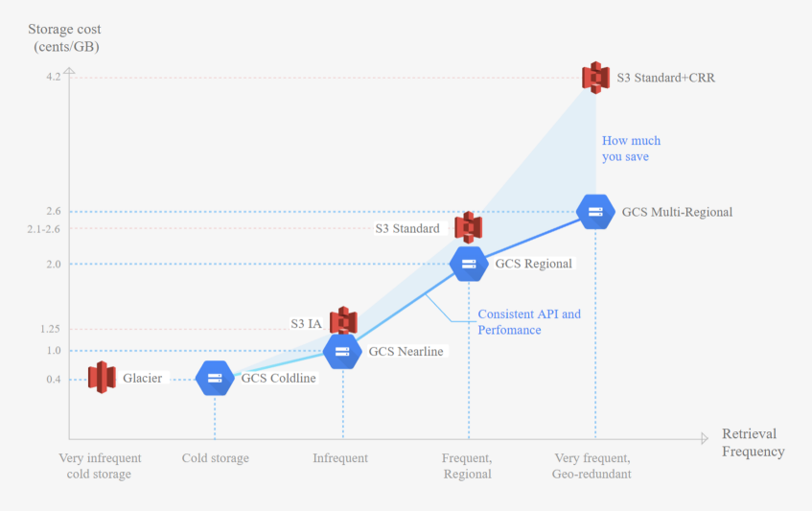
Storage: AWS vs. GCP
AWS S3 Bucket is more desirable option
Infrequent Retrieval since it will be stored in a database/ data warehouse

Slide 11
Compute: AWS vs. GCP
 | AWS Lambda | GCP Cloud Functions
Pricing: Free Monthly Duration (GB-seconds) Free Monthly Requests Cost of Each Additional 1 Million Requests Cost of Each Additional 1 GB-second | 400,000 1 Million $0.20 $0.000016 | 400,000 2 Million $0.40 $0.0000125
Execution Time - Maximum Timeout | 15 minutes | 9 minutes
Memory | 128 MB – 10240 MB | 128 MB – 4096 MB (in multiples of 128 MB)
AWS Lambda is more desirable option - More execution time and memory

Slide 12
Database: AWS vs. GCP
 | AWS Redshift | GCP BigQuery
Pricing | Storage: $306 per TB per month Queries: unlimited processing Pricing by on-demand/by-the-hour nature | Storage: $20 per TB per month Queries: $5/TB Pricing by query
3 Key Differences of RedShift vs. BigQuery
Amazon RedShift is provisioned on clusters and nodes. Google BigQuery is serverless.
RedShift supports 1,600 columns in a single table, BigQuery supports 10,000 columns.
RedShift requires periodic management tasks like vacuuming tables, BigQuery has automatic management.
GCP BigQuery is more desirable option – Variant workload

Slide 13
Machine Learning: AWS vs. GCP
 | Amazon Sagemaker Autopilot | Google Cloud AutoML
Pricing: Free Monthly Duration (GB-seconds) Free Monthly Requests Cost of Each Additional 1 Million Requests Cost of Each Additional 1 GB-second | 400,000 1 Million $0.20 $0.000016 | 400,000 2 Million $0.40 $0.0000125
Execution Time - Maximum Timeout | 15 minutes | 9 minutes
Memory | 128 MB – 10240 MB | 128 MB – 4096 MB (in multiples of 128 MB)
AWS Lambda is more desirable option - More execution time and memory

Slide 14
Machine Learning: AWS vs. GCP
AWS: Amazon Sagemaker Autopilot
GCP: Google Cloud AutoML
Both offers very similar capabilities

Slide 15
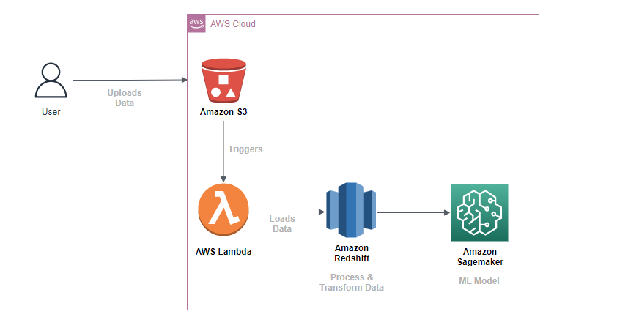
AWS Solution Architecture

Slide 16
Implementation of Architecture

Slide 17
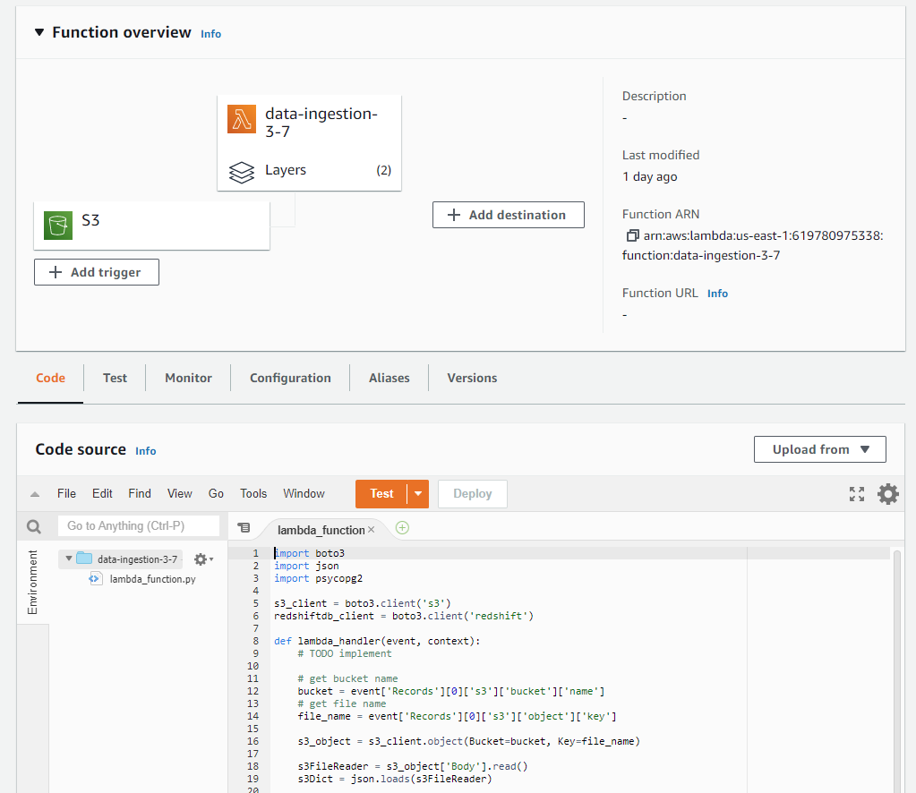
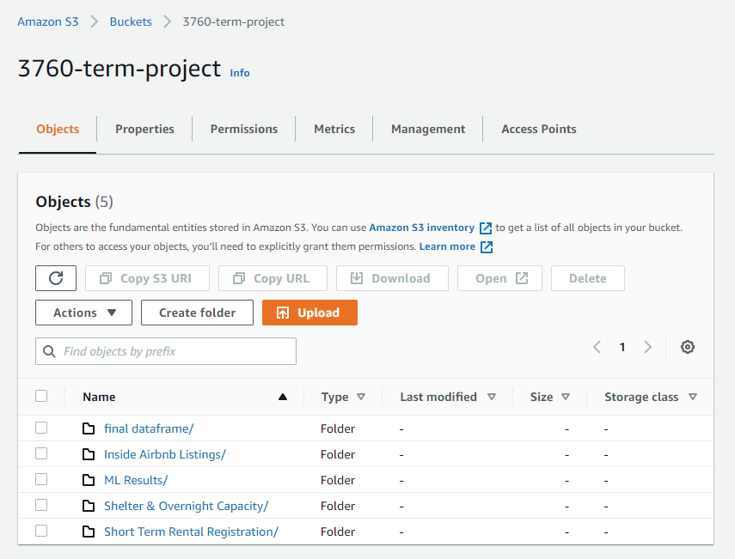
AWS Lambda
Amazon S3

Slide 18
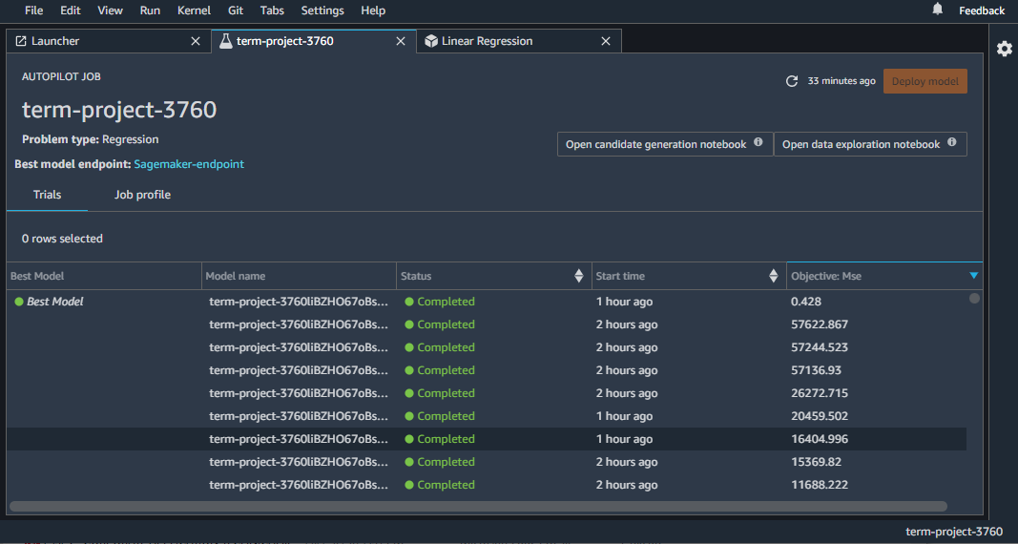
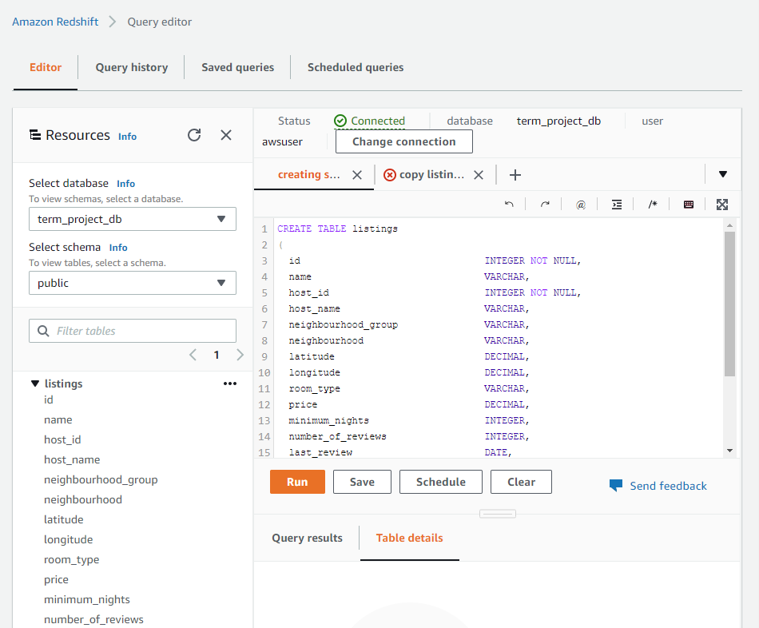
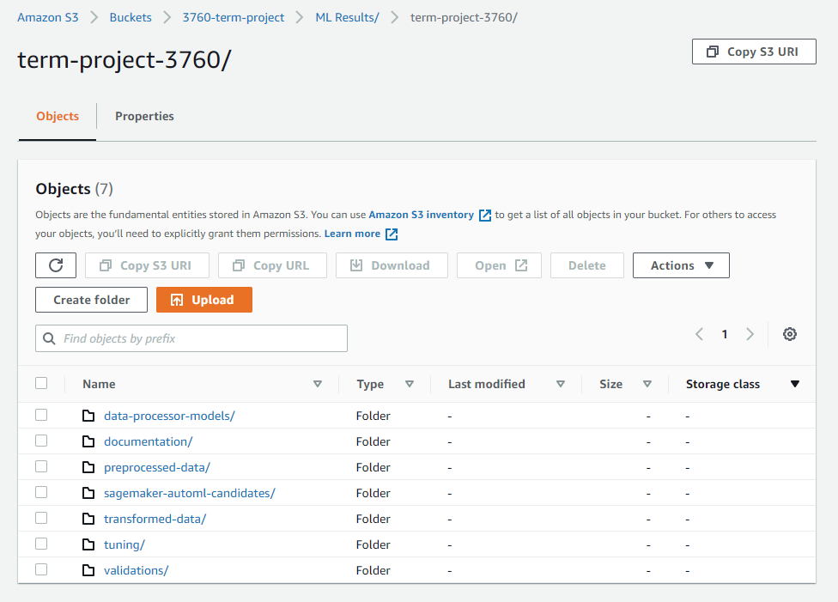
Amazon SageMaker Autopilot
Amazon Redshift

Slide 19
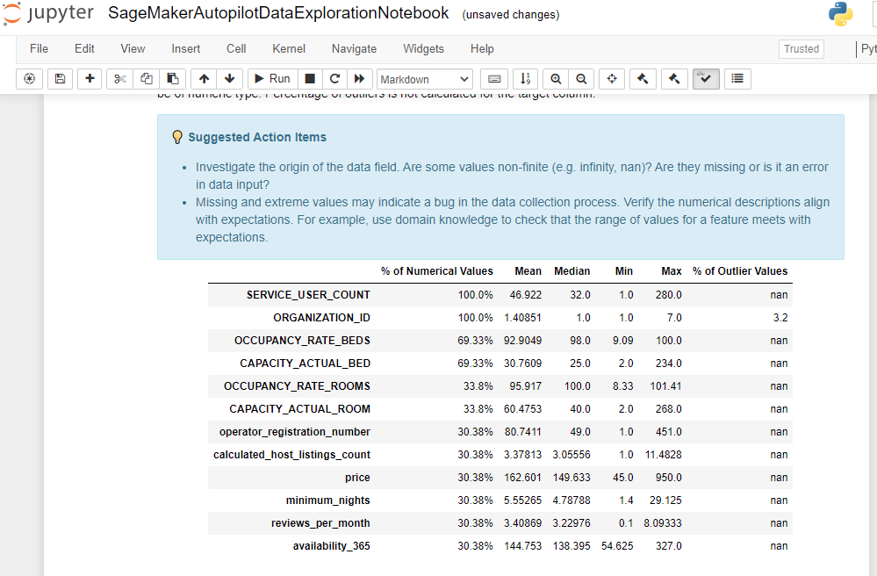
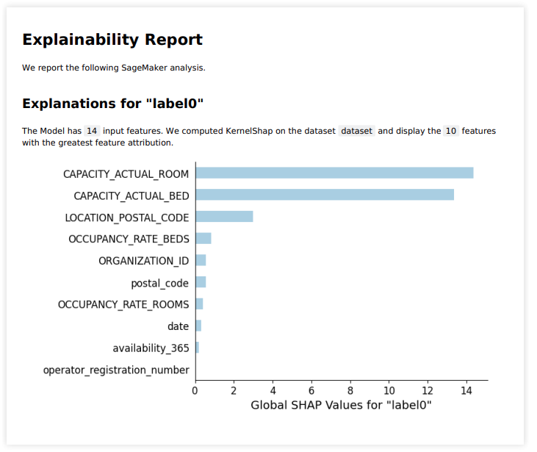
Amazon SageMaker Autopilot - Results

Slide 20
Challenges

Slide 21
Challenges
City of Toronto’s API only provided first 100 records
Attaching layer to lambda
Creating IAM Roles for Redshift

